Slide 1
AI-Powered Insights for Student Retention
(Week4-Final Report)
AI-Powered Data Insights Virtual Internship
Team: AI Team 5 – Excelerate Cohort 1404
Members: Moneka Meghwar, Parimala Darshini, Mohammad Saber
Date: May 11, 2025

Slide 2
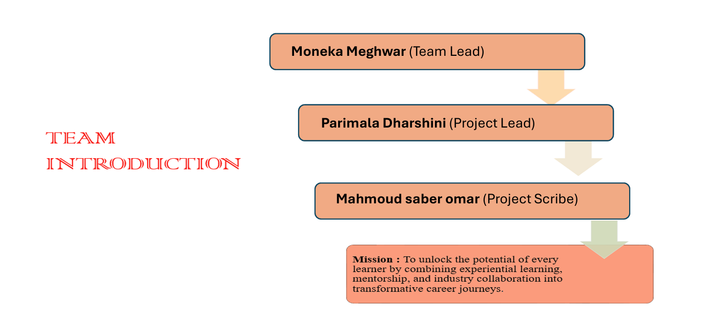

Slide 3
Agenda
Overview
Introduction
Data Analysis Overview
Exploratory Data Analysis (EDA) Insights
Churn Analysis Insights
Predictive Modeling
Recommendation System
Actionable Insights
Conclusion

Slide 4
Introduction
Background: Excelerate offers different opportunities but faces high dropout rates.
Problem: Only 17/5,668 users completed opportunities (low completion rate).
Goal: Identify churn drivers on Excelerate’s platform to enhance engagement and retention via AI-driven insights. Leverage data science and machine learning for actionable insights.
Approach:
Data preprocessing and EDA.
Predictive modeling.
Rule-based recommendation system.

Slide 5
Data Analysis Overview
Dataset: SLU’s Student Engagement dataset comprised of:
User data: Age, Gender, Country, Major, Institution
Engagement data: Status, Apply/Signup Dates, Rewards
Opportunity data: Category, Duration, Start/End Dates
Preprocessing:
Handled missing values by replacing critical fields like “Institution Name” and “Major” with defaults ("Unknown", "Undeclared"). Removed duplicates and invalid/malformed entries.
Standardized text formatting (e.g., title-casing genders, removing extra spaces).
Ensured date consistency across columns using pd.to_datetime () with error coercion.
Created engineered features, including: Age, Opportunity Duration, Completion Time, and Engagement Score ,Application Timing flag (early vs. late applications)
EDA: Analyzed sign-ups, completions, demographics,
Modeling: Random Forest led with 96% accuracy.

Slide 6
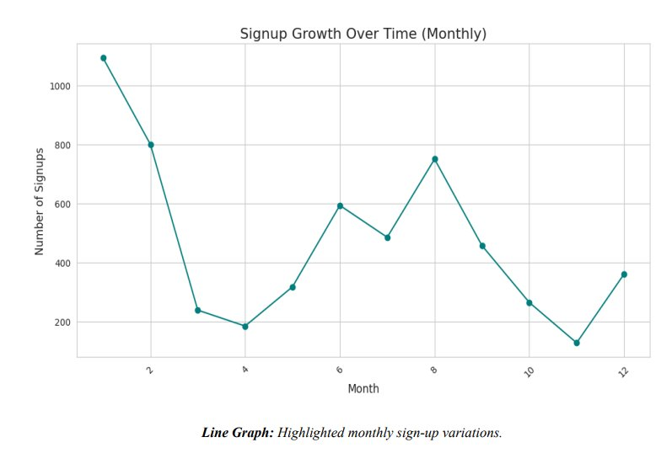
Exploratory Data Analysis (EDA) Insights
Monthly Sign-Up Trends​:

Slide 7
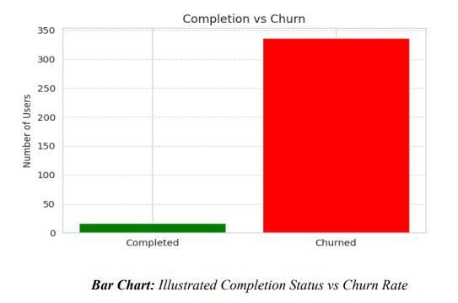
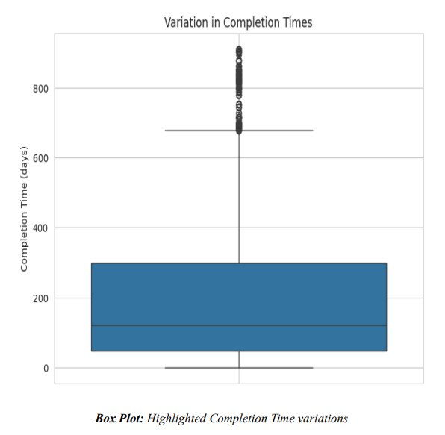
Exploratory Data Analysis (EDA) Insights
Completion Rate vs Churn rate
Completion Time variations

Slide 8
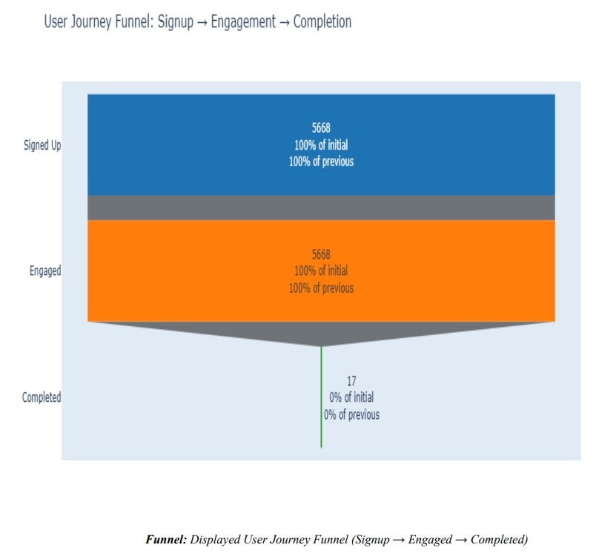
Exploratory Data Analysis (EDA) Insights
User Journey Funnel:
Massive drop-offs occur post-engagement; only 17 completions out of 5,668 signups​
Completion rate is extremely low—only 0.3%.​
​

Slide 9
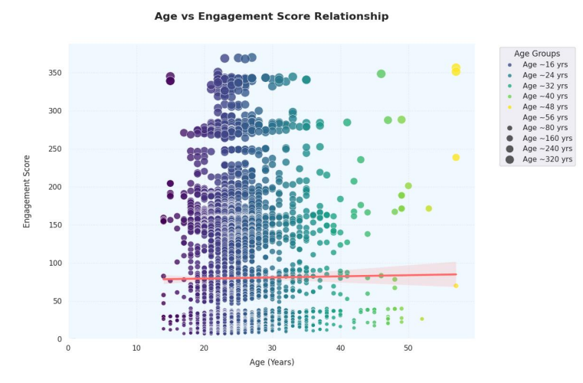
Exploratory Data Analysis (EDA) Insights
Engagement Score based on Age
Peak engagement between ages 22–25, dips before 20 and after 26​
​

Slide 10
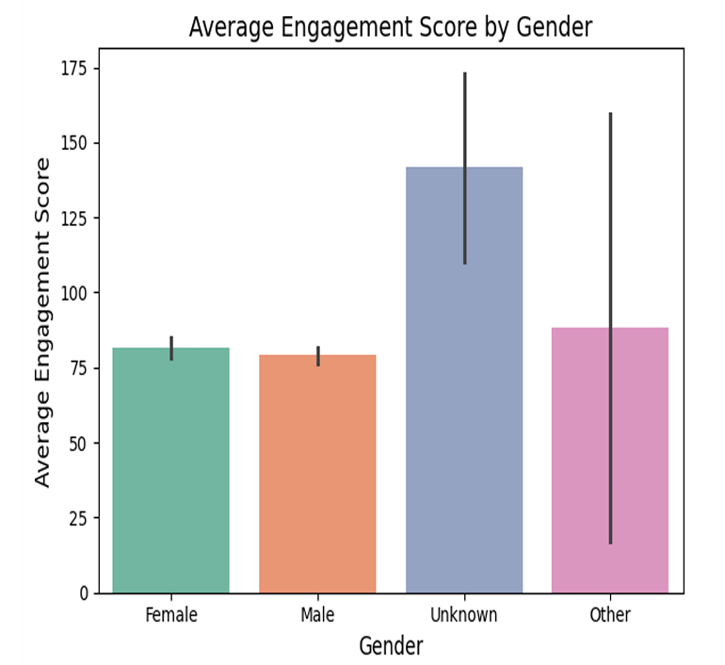
Exploratory Data Analysis (EDA) Insights
Engagement Score by Gender
Males and females have nearly identical scores. The seemingly higher scores for “Other” and “Unknown” genders come with huge variance bars,

Slide 11
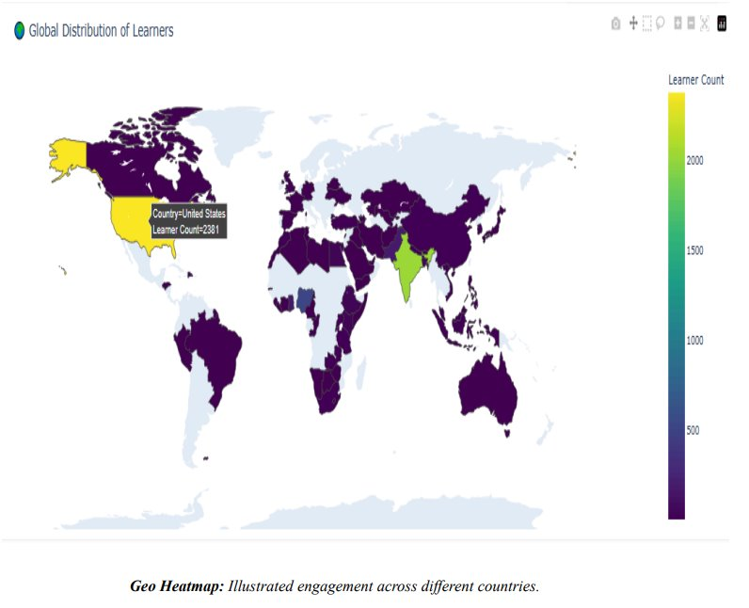
Exploratory Data Analysis (EDA) Insights
Geo Heatmap – Learner Locations​
U.S. and India dominate the learner base., highlights potential for regional strategies.​

Slide 12
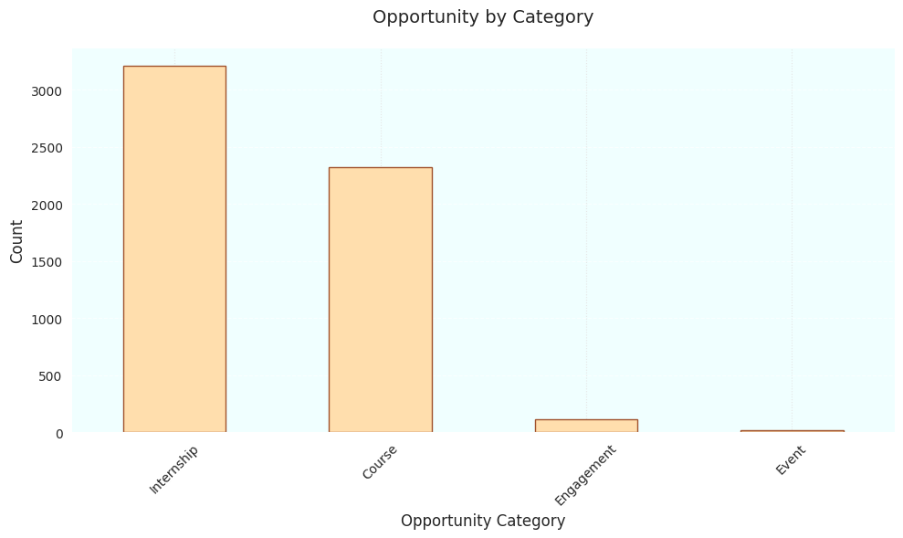
Exploratory Data Analysis (EDA) Insights
Opportunities Categories:

Slide 13
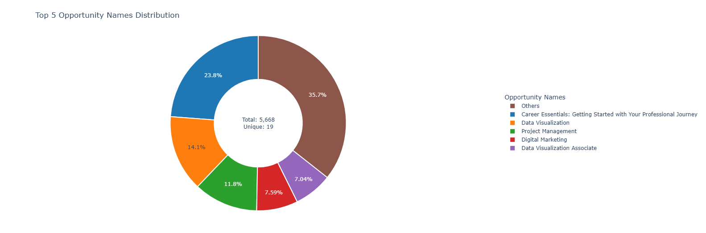
Exploratory Data Analysis (EDA) Insights
Top Opportunities Names:

Slide 14
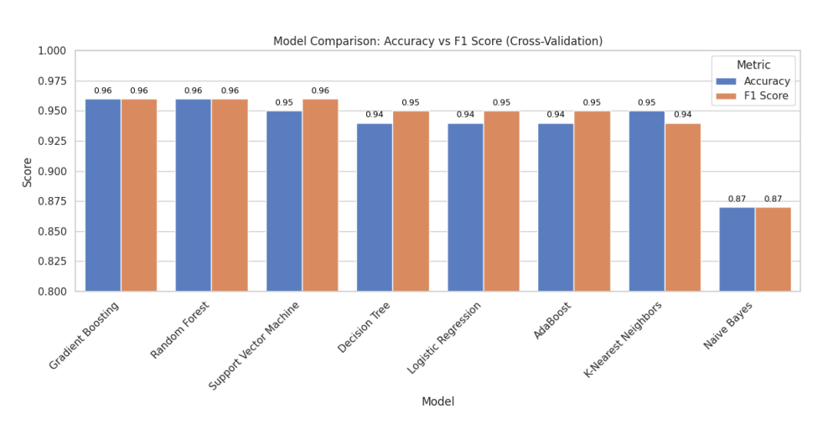
Predictive Modeling
Models Tested: Random Forest, Gradient Boosting, SVM, Decision Tree, Naive Bayes, Logistic Regression, KNN, Ada Boosting.
Best Model: Random Forest
Accuracy: 96%, F1 Score: 96%.
False negatives: 33, false positives: 33.
Key Features: Engagement_Score, Completion Time, Application_Timing, Opportunity_Category.
Why Random Forest?: Robust, handles feature interactions, minimizes errors.

Slide 15
Rule-Based Recommendation System
Design: Rule-based recommendations for churned (Dropped Out, Withdraw) and at-risk (Started, Waitlisted, Applied) students.
Features:
Existing: Engagement_Score, Completion Time, Age, Opportunity_Category, Major_Category.
New: Time Since Signup, Engagement Duration.
ID: Learner SignUp DateTime with Temp_ID for duplicates.
Interventions:
Low engagement: Gamified courses (Age ≤18), mentorship (Age >30).
High engagement: Advanced modules (Engagement_Score ≥80).
Long tenure: Re-engagement campaigns (Time Since Signup >365 days).
Major-specific: Coding challenges (CS/IT), webinars (Business/Other).
Scalability: Configurable thresholds, vectorized operations, API-ready CSV output.

Slide 16
Conclusion
Deliverables:
Churn analysis (5.95% dropout, key predictors).
Scalable recommendation system.
Retention strategies for Excelerate.
Strategies:
Early Engagement: Onboarding emails for early applicants. Encourage early applications with reminders and incentives.​
Personalized Nudging: Tailored by age, major, engagement.
Gamified Learning: Interactive modules for younger learners to boost participation.
Opportunity Support: Workshops, mentors for high-churn or high-risk users and engagement nudges..
Re-Engagement: Free micro-courses for churned students.

Slide 17

Thank you for your attention and support throughout our journey.
We look forward to contributing to Excelerate’s mission of empowering learners!

